Slide 1
Class construction - Inheritance, polymorphism & super
Dr. Jeff Hill

Slide 2
Midterm Results
Grade | Number
A | 8
B | 6
C | 5
D | 1
F | 3
Statistic | Value
Mean | 79.54
Median | 85

Slide 3
Inheritance
Provides another method of splitting class definitions across multiple class/code files
Why? What possible benefit could justify making things this complex?
Code reuse
How does it differ from the basic techniques we learned earlier?
Aggregation & composition break up concepts into separate classes but define each concept in its own independent class
Cars and doors, people and organs, etc.
Inheritance breaks up concepts into separate classes, but defines each concept in relation to other similar concepts
Student is a human, professor is a human

Slide 4
Inheritance hierarchy
Human
Student
Professor
The relationships between concepts create a hierarchy
This hierarchy allows us to create classes with members that will be inherited by other classes at a lower level in the hierarchy
Why? What is the benefit?
There are many similarities between Student and Professor
First name, last name, Bear ID, phone number, address, etc.
This would cause a lot of code duplication
Inheritance allows us to define these similarities one single time in code in the superclass
The subclasses automatically inherit all members without needing to explicitly code it again and again and again

Slide 5
Inheritance
This is referred to as coding in the general
We place members as high up in the hierarchy as is reasonable
“Generally speaking, people at UCA have a first name, last name, Bear ID, phone number, address, etc.”
Therefore, our superclass would contain these members
The subclasses would all inherit these members
But we only have to code them one single time
This fosters code reuse
As a general rule, if you are coding something twice (or more)… you are doing something wrong or missing some technique

Slide 6
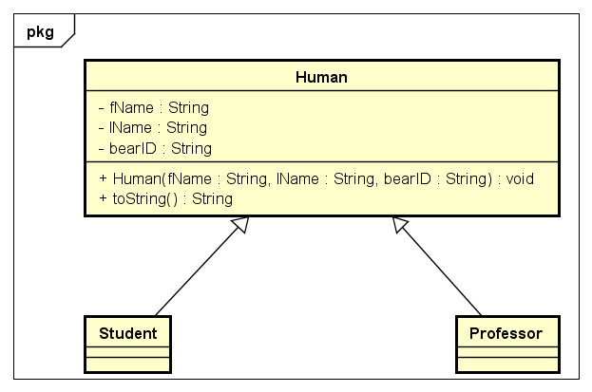
Inheritance
Where to start?
Figure out what concepts/entities you are going to need to model for a given business problem
If we’re making a program about classrooms…
We need both students and professors
We need to recognize the similarities between students and professors
When we recognize those similarities, we create a hierarchy
Code the necessary members as high up as is possible

Slide 7
Code
package class16;
public abstract class Human {
private final String fName;
private final String lName;
private final String bearID;
public Human(String fName, String lName, String bearID) {
this.fName = fName;
this.lName = lName;
this.bearID = bearID;
} // end ctor
@Override
public String toString() {
return "This human named " + this.fName + " " + this.lName +
" Bear ID #: " + this.bearID;
} // end toString
} // end Human
Superclass
package class16;
public class Student extends Human {
public Student(String fName, String lName, String bearID) {
super(fName, lName, bearID);
} // end ctor
} // end Student
Subclass
package class16;
public class Professor extends Human {
public Professor(String fName, String lName, String bearID) {
super(fName, lName, bearID);
} // end ctor
} // end Professor
Subclass
package class16;
public class Driver {
public static void main(String[] args) {
Professor me = new Professor("Jeff","Hill","B012345ABC");
System.out.println(me);
} // end main
} // end Driver
Driver
Subclasses extend superclass
Subclasses have required specific ctor
Driver instantiates subclasses, not superclass
Superclass is abstract

Slide 8
Abstraction
Superclasses are generally marked as abstract to prevent instantiation
This is because not everything will be coded into the superclass
This means superclasses are incomplete
They only tell “part of the story”
To get the whole story, we need to flesh out the subclasses as well
This “fleshing out” will be how we code members that aren’t shared across all subclasses

Slide 9
Professor specific
Professor
public String giveQuiz() {
return "What is the square root of PI?";
} // end giveQuiz
Inheritance itself is a fairly simple concept, just think it through…
Put members as high up the hierarchy as is reasonable
Any member that is not general to the subclasses should be coded into the appropriate subclass(es)
Let’s give a professor the ability to give a quiz
This shouldn’t be placed into the superclass as students should not be able to give quizzes
So only code this member in the Professor subclass
Sometimes when we have many subclasses, members may be appropriate to more than one subclass, but not all
We need to decide:
Is it ok for non-users to have the ability, just don’t use it → put in superclass
Non-users must not have the ability → put in subclasses, redundantly if necessary
Or maybe use interfaces to reduce redundancies, but we’ll get to this next class…
Driver
System.out.println(me.giveQuiz());

Slide 10
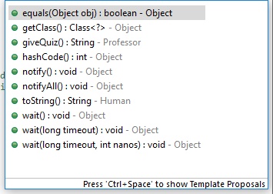
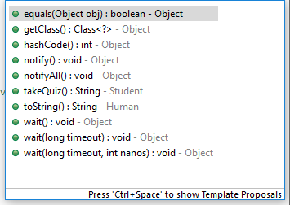
Student specific
Student
public String takeQuiz() {
return "My answer is: " + Math.random();
} // end takeQuiz
Let’s give students the ability to take a quiz
Notice the IDE’s context-specific predictive code complete correctly has the methods specific to each class type as appropriate
Student
Professor
Student you = new Student("Grace","Hopper","B0987654ZYX");
System.out.println(you);
System.out.println(you.takeQuiz());
Driver

Slide 11

Similar, but still different
Coding individual variables is not generally a best practice
e.g. prior “me” and “you” examples for Professor and Student respectively
Instead we often want to put things into collections
Lets us “manage” groups using a single variable reference and loops
Here is the problem
Even though we have created an inheritance hierarchy…
A Student instance and a Professor instance are not the same type, thus can’t coexist in a single collection!
e.g. ArrayList<Professor> can NOT contain Student instances!
There is more to inheritance…
By declaring a collection whose type is the superclass…
We can place any subclass type into this collection!

Slide 12
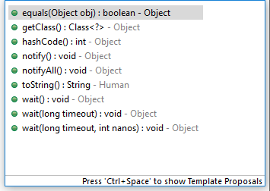
Polymorphism
Means “having many forms”
Allows a superclass reference to still behave correctly as to its actual base type
Human studentOne = new Student("Steve","Jobs","B123456QWR");
There ain’t no such thing as a free lunch (TANSTAAFL)
Polymorphic references “lose” the ability for us to code class specific behaviors
Notice studentOne can’t give or take a quiz!
Because those behaviors exist in the subclass only…

Slide 13
“Is-a”
Human
Human studentOne = new Student("Steve","Jobs","B123456QWR");
Student
Professor
The variable “studentOne” is declared as a Human type
Superclasses have no knowledge of their subclasses
Human knows nothing about Student or Professor
Conversely, Student and Professor know everything about Human
This creates what is known as a “is-a” relationship
A Student (or a Professor) is a human
This relationship is uni-directional
A Human is NOT a Student (or a Professor)
This relationship is only vertical (not horizontal)
A Student is NOT a Professor (or vice versa)
Polymorphism allows a subclass object (Student) to be referred to by a superclass type (Human)
But, they do not have the “abilities” of the subclass(es)!

Slide 14
Polymorphism
Polymorphism is a bit more complex of a concept, but if you think it though it isn’t too bad
Start off with an inheritance hierarchy
Genericize method names where possible
We’ll come back to this in a bit, this is how we’ll be able to fix the .giveQuiz() & .takeQuiz() problem
Recognize where we want classes to have same named methods, but different actions when those methods are invoked
This is how we can fix the .toString() method output to say “student” or “professor” as appropriate instead of just “human”
Instead of coding a concrete method implementation in the superclass, just put in an abstract method stub
This is what makes method names “valid” in the superclass context even though they aren’t actually coded except in the subclasses
Create the actual concrete method implementations in each subclass
Because the superclass contains the .toString() method, a polymorphic superclass reference can validly invoke the .toString() method

Slide 15

TANSTAAFL
If we put this code in the Student class…
Encapsulation protects private data members from being accessed from other classes!
The fix?
The “wrong” way: the text tells you to use the protected visibility modifier instead of private
Protected opens the visibility to any class inside the package not just subclasses as the text implies – this is a violation of the encapsulation principle
The “right” way: create public accessor methods in the superclass
Subclasses then inherit these accessors while the encapsulation principle is maintained

Slide 16
The fix
Superclass
public String getfName() {
return this.fName;
} // end getfName
public String getlName() {
return this.lName;
} // end getlName
public String getBearID() {
return this.bearID;
} // end getBearID
@Override
public abstract String toString();
Now, when we run the program
The .toString() method outputs “professor” or “student” as appropriate instead of the generic “human”
Notice: no changes are needed to the Driver class!
We can leave the default alone, but since it is not being used at all…
We should create an abstract method stub
Every subclass must provide a concrete implementation for any abstract method stub(s) in the superclass!
Superclass
Student
@Override
public String toString() {
return "This student named " + this.getfName() + " " + this.getlName() + " Bear ID #: " + this.getBearID();
} // end toString
Professor
@Override
public String toString() {
return "This professor named " + this.getfName() + " " + this.getlName() + " Bear ID #: " + this.getBearID();
} // end toString

Slide 17
Polymorphism
That is how polymorphic behavior is created in code
Superclass has an abstract method stub or a default concrete implementation
Subclasses @Override as necessary to create behavior specific to itself
When run, every object will use the concrete method implementation appropriate to its own type
We can also create concrete method implementations in the superclass that serve as a “default”
Then, in specific subclasses we create override concrete method implementations specific to that subclass

Slide 18
Breathing
public String breathe() {
return this + " breathes.";
} // end breathe
Superclass
Students and professors all breathe
How do we implement this “functionality”?
Create a .breathe() method in the superclass
Everyone breathes air the same as everyone else
Because the .breathe() method invocation is valid to superclass references…
Polymorphic references can invoke the method!
System.out.println(studentOne.breathe());
System.out.println(me.breathe());
System.out.println(you.breathe());
Driver

Slide 19
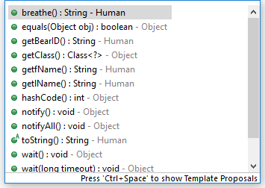
Genericize method names
Remember, the polymorphic Human reference can’t “see” the .takeQuiz() or .giveQuiz() methods?
What if we changed these to .doQuiz()?
This name is still appropriate in that a Professor “doing” a quiz gives the questions, and a Student “doing” a quiz gives answers
This results in exactly the same process we did to fix .toString()
Make it visible to the superclass, make the behavior proper for each subclass

Slide 20
The code
Change the method’s name in both subclasses to “doQuiz” with no parameters
Create an abstract method stub for .doQuiz() in the superclass
Student
Superclass
@Override
public String doQuiz() {
return "My answer is: " + Math.random();
} // end toString
public abstract String doQuiz();
Driver
System.out.println(studentOne);
System.out.println(studentOne.doQuiz());
Professor
@Override
public String doQuiz() {
return "What is the square root of PI?";
} // end toString
Also change the no longer valid .takeQuiz() and .doQuiz() invocations!

Slide 21
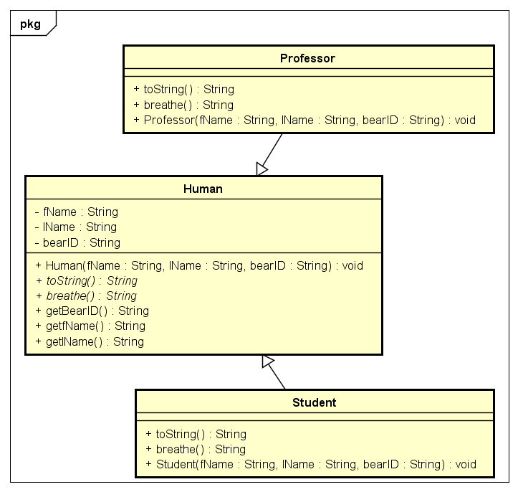
Putting it all together
ArrayList<Human> roster = new ArrayList();
roster.add(new Professor("Jeff","Hill","B012345ABC"));
roster.add(new Student("Grace","Hopper","B0987654ZYX"));
roster.add(new Student("Steve","Jobs","B123456QWR"));
for (Human eachOne: roster) {
System.out.println(eachOne.toString());
System.out.println(eachOne.doQuiz());
System.out.println(eachOne.breathe());
} // end for
Driver
Now, because all methods are invokable from a polymorphic superclass reference…
We can get rid of the individual variables (e.g. me, you, studentOne) and use a collection
Once the hierarchy is setup properly, this is all done in the Driver class…
The results will be the same, but this gives us the flexibility of using a collection instead of managing a series of variables

Slide 22
Questions?

